Slide 1
Homework 1 Due: Feb. 13, Monday at 11:59pm
Midterm Exam 1
Feb. 15, Next Wednesday
Notes:
A heading at the top of your file contains your group ID, the names of your group members, and your Auburn UserIDs.
Submit your solution as a PDF file named as ““<group_ID>_hw1.pdf” through Canvas (for example, mine might read “group06_hw1.pdf”)
Each group must submit a single PDF file that contains:
Group member 1’s answers
Group member 2’s answers
Group member 3’s answers
Group answers after your discussion
If the three group members’ answers agree with one another, you simply pick the answer with better presentation as your group answers.
If the three members’ answers are different, the group members have to discuss and determine whose answer is correct. The correct one should be submitted as the group answer.
In the above two cases, your team must clarify whose answers are adopted.
TA will only grade your group answers. However, if you (1) do not provide each member’s individual answers or (2) you do not clarify whose answers are adopted, your team will lose 20 points. Although your group members may share different answers, the group members should have an agreement on the group answers.

Slide 2
Office Hours

Slide 3
What’s up for this weekend?

Slide 4
Photo Courtesy of Rai University
Notes:
Credit: http://www.raiuniversity.edu/blogs/5-stupid-things-students-usually-cramping-exams/

Slide 5
COMP 3500 Introduction to Operating Systems Synchronization: Part 5 Exercises
Dr. Xiao Qin
Auburn University http://www.eng.auburn.edu/~xqin
xqin@auburn.edu
Notes:
45 Minutes: Slides 1-12.
Ex 1-6. No time to work on Ex 7.
4 Minutes on the overview of project 3.

Slide 6
Concurrent Computing vs. Parallel Computing
Reference: https://en.wikipedia.org/wiki/Concurrent_computing
Notes:
63 languages support concurrent computing.
Concurrent computing is related to but distinct from parallel computing, though these concepts are frequently confused,^{[2][3]} and both can be described as "multiple processes executing during the same period of time". In parallel computing, execution occurs at the same physical instant, for example on separate processors of a multi-processormachine, with the goal of speeding up computations—parallel computing is impossible on a (one-core) single processor, as only one computation can occur at any instant (during any single clock cycle).^{[a]} By contrast, concurrent computing consists of processlifetimes overlapping, but execution need not happen at the same instant.
In programming, concurrency is the composition of independently executing processes, while parallelism is the simultaneous execution of (possibly related) computations. Concurrency is about dealing with lots of things at once. Parallelism is about doing lots of things at once.

Slide 7
Rob Pike: Concurrency is not Parallelism
Notes:
Rob Pike: Rob Pike is a Distinguished Engineer at Google, Inc. He works on distributed systems, data mining, programming languages, and software development tools. Most recently he has been a co-designer and developer of the Go programming language.
Robert Pike (born 1956) is a Canadian programmer and author. He is best known for his work at Bell Labs, where he was a member of the Unix team and was involved in the creation of the Plan 9 from Bell Labs and Inferno operating systems, as well as theLimbo programming language.
He also co-developed the Blit graphical terminal for Unix; before that he wrote the first window system for Unix in 1981. Pike is the sole inventor named in AT&T's US patent 4,555,775 or "backing store patent" that is part of the X graphic system protocol and one of the first software patents.^{[1]}
Over the years Pike has written many text editors; sam^{[2]} and acme are the most well known and are still in active use and development.
Pike, with Brian Kernighan, is the co-author of The Practice of Programming and The Unix Programming Environment. With Ken Thompson he is the co-creator of UTF-8. Pike also developed lesser systems such as the vismon program for displaying images of faces of email authors.
"Concurrency is not Parallelism", Waza conference Jan 11, 2012, Rob Pike (slides) (video)

Slide 8
Exercise 1 (Plicker): What is the sequence of Pi and Pj?
Use semaphore flag initialized to 0
Code:
Proc_{i} Proc_{j}
 
Pi wait(flag)
signal(flag) Pj
P(S): S.value--;
if (S.value < 0) {
add this process to S.L; block;
}
V(S): S.value++;
if (S.value <= 0) {
remove a process P from S.L; wakeup(P);
}
Execute A in P_{j} only after B executed in P_{i}
Notes:
Semaphore as a General Synchronization Tool

Slide 9
Exercise 2: What is the execution sequence of proc_A and proc_B?
proc_A() {
while(TRUE) {
<compute section A1>;
update(x);
/* Signal proc_B */
V(s1);
<compute section A2>;
/* Wait for proc_B */
P(s2);
retrieve(y);
}
}
semaphore s1 = 0;
semaphore s2 = 0;
fork(proc_A, 0);
fork(proc_B, 0);
proc_B() {
while(TRUE) {
/* Wait for proc_A */
P(s1);
retrieve(x);
<compute section B1>;
update(y);
/* Signal proc_A */
V(s2);
<compute section B2>;
}
}
Semaphores: P=wait; V=signal
Two shared variables: x and y
Critical Sections
Synchronizations

Slide 10
Device Controller Synchronization
The semaphore principle is logically used with the busy and done flags in a controller
Driver signals controller with a V(busy), then waits for completion with P(done)
Controller waits for work with P(busy), then announces completion with V(done)

Slide 11
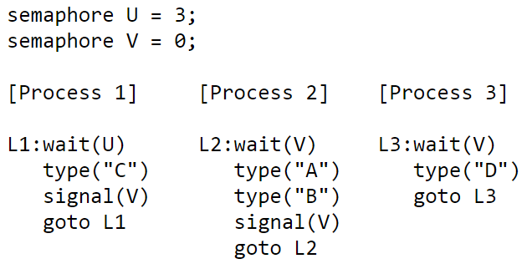
Exercise 3 (Plicker): There are three interacting processes. We assume that the execution is eventually halted. How many C's are printed when the set of processes runs?
Notes:
Within each process the statements are executed sequentially, but statements from different processes can be interleaved in any order that's consistent with the constraints imposed by the semaphores. When answering the questions below assume that once execution begins, the processes will be allowed to run until all 3 processes are stuck in a wait() statement, at which point execution is halted.
Exactly 3. Each time Process 1 executes the "wait(U)" statement, the value of semaphore U is decremented by 1. Since there are no "signal(U)" statements, the loop in Process 1 will execute only 3 times (ie, the initial value of U) and then stall the fourth time "wait(U)" is executed.

Slide 12
Exercise 4 (Plicker): There are three interacting processes. We assume that the execution is eventually halted. How many D's are printed when this set of processes runs?
Notes:
Exactly 3. Process 1 will execute its loop three times (see the answer to the previous question), incrementing "signal(V)" each time through the loop. This will permit "wait(V)" to complete three times. For every "wait(V)" Process 2 executes, it also executes a "signal(V)" so there is no net change in the value of semaphore V caused by Process 2. Process 3 does decrement the value of semaphore V, typing out "D" each time it does so. So Process 3 will eventually loop as many times as Process 1.

Slide 13
Exercise 5 (Plicker): What is the smallest number of A's that might be printed when this set of processes runs?
Notes:
0. If Process 3 is scheduled immediately after Process 1 executes "signal(V)", then Process 2 might continue being stalled at its "wait(V)" statement and hence never execute its "type" statements.

Slide 14
Exercise 6 (Plicker): Is CABABDDCABCABD a possible output sequence when this set of processes runs? Why?
Notes:
No. Here are the events implied by the sequence above:start: U=3 V=0 type C: U=2 V=1 type A: U=2 V=0 type B: U=2 V=1 type A: U=2 V=0 type B: U=2 V=1 type D: U=2 V=0 type D: oops, impossible since V=0

Slide 15
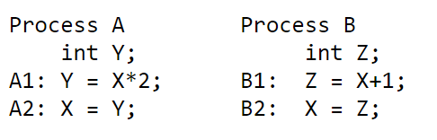
Exercise 7 (Plicker): Two processes share a common variable X. X is set to 5 before either process begins execution. Statements within a process are executed sequentially. How many different values of X are possible after both processes finish executing?
6 possible ways in which statements A and B can be interleaved.
4 possible values for X.
Notes:
There are four possible values for X. Here are the possible ways in which statements from A and B can be interleaved.
A1 A2 B1 B2: X = 11
A1 B1 A2 B2: X = 6
A1 B1 B2 A2: X = 10
B1 A1 B2 A2: X = 10
B1 A1 A2 B2: X = 6
B1 B2 A1 A2: X = 12
Use graphs
Y = X*2
|
V
X= Y -→ Z= X+1
|
V
X= Z
Z = X + 1
|
V
X= Z -→ Y= X*2
|
V
X= Y
Y = X*2
|
V
X= Y
Z = X + 1
|
V
X= Z

